Slide 1
SPM -Chapter 4- ITIL
The Information Technology Infrastructure Library (ITIL)
By Dr Shilpa Paralikar

Slide 2
Syllabus
4 ITIL
4.1 ITIL principles and framework
4.2 ITIL service management and project management
4.3 Demonstration using tool service desk/OTRS

Slide 3
What is ITIL?
ITIL is a set of practices. Its primary purpose is to provide a systematic approach to IT service management (ITSM).
ITIL benefits
Any organization can use ITIL, from small businesses in the US to large-scale enterprises abroad. It provides a flexible roadmap for organizations to follow when undertaking a digital transformation. A few more reasons a company may align their IT processes with the ITIL framework include:
Standardization. As mentioned above, standardization is one of the primary goals of the ITIL foundation. ITIL helps create predictable IT environments, making it easier to manage risks, problem solve, and streamline processes.
Transparency. Establishing a set of standards helps improve visibility into IT costs and operations. ITIL helps bridge the gap between departments by enabling IT admin to be front-end business service partners in addition to back-end support.

Slide 4
ITIL benefits . . . . Continued
Cost-effectiveness. The ITIL framework is designed to help organizations use their hardware and software resources as efficiently as possible.
Strategic alignment. Similar to DevOps methodology, the ITIL framework seeks to unite business operations and IT departments. Enhanced communication helps organizations better translate business strategies and goals into technical requirements.
Organizational change management. The ITIL foundation includes best practices for change management. With these guidelines, IT professionals can release changes without interrupting service.

Slide 5
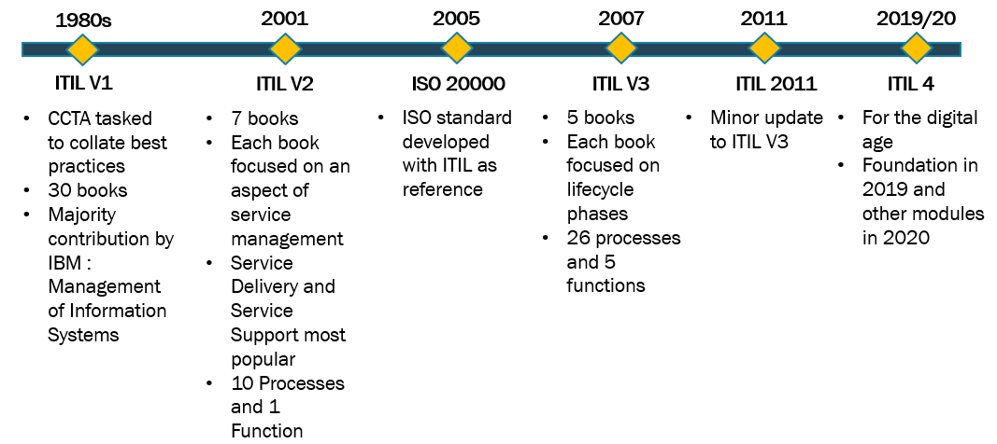
History of ITIL:
When the British government recognized the quality of its IT services wasn’t up to par in the 1980s, ITIL was born. The Office of Government Commerce (OGC), originally known as the “The Central Computer and Telecommunications Agency (CCTA)”, was entrusted with developing a set of standard practices to connect public and private sector IT systems better. The goal was to create a more efficient framework and a more cost-effective utilization of IT resources.

Slide 6
ITIL V1 - The Beginning
The first edition of ITIL covered procedures including change management, help desk management, and software distribution and control. Contingency planning, Capacity management, availability management, and cost management were also addressed, some of which are still important today.
ITIL V2 - The First Major Revision
In 2001, the second edition of ITIL was released. The emphasis in this edition was on removing duplicate entries, improving topic coherence, and adding IT concepts. Problem management, incident management, security management, financial management of IT assets, release management and service continuity management were among the subjects covered in ITIL v2.
ITIL V3 - Introduction of The Service Lifecycle
ITIL version 3 was released in 2007. This took a more lifecycle approach to service management, focusing more on IT business integration. This version is an update that includes 26 processes and functions organized into five volumes that focus on service strategy, transition, design, operation, and continuous service improvement.

Slide 7
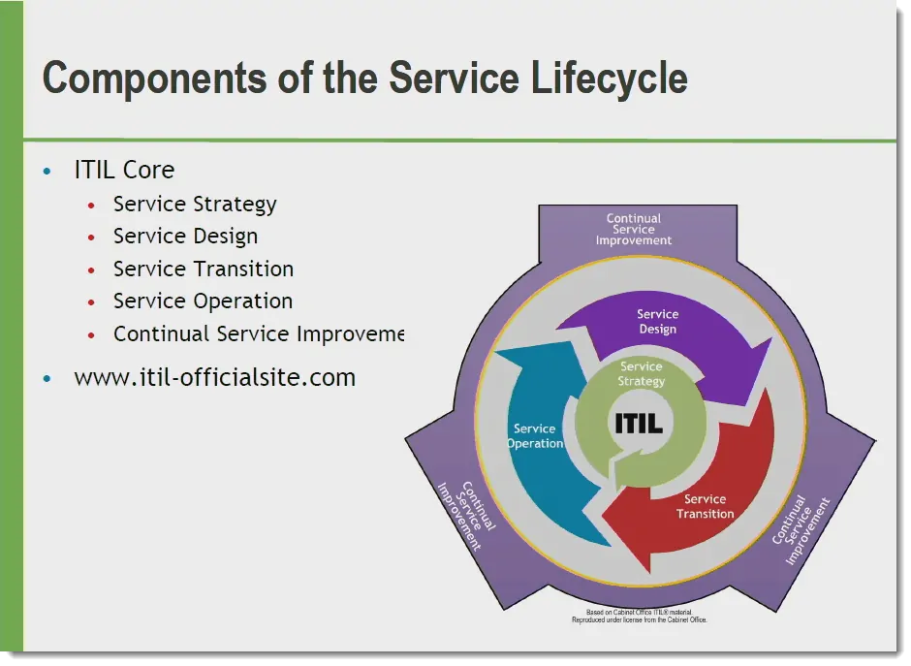

Slide 8
1. Service strategy
The phrase service strategy refers to the phase of the ITIL process that syncs business goals with the IT service lifecycle. Service strategy has four subcategories:
Service portfolio management. A service portfolio is the scope of services the service provider manages. Managing this portfolio requires each service to be identified and evaluated to establish its role in the IT process. Service portfolio management includes the Service Pipeline, Service Catalog, and Retired Services.
Demand management. IT professionals use user profiles and Patterns of Business Activity (PBA) to analyze and influence customer demand for better customer satisfaction.
Financial management. All accounting, budgeting, and transactional processes associated with the IT department occur during this phase of the ITIL framework.
Strategy operations. During the strategy operations phase, it’s essential to ensure routine IT operations are running smoothly and efficiently. This phase provides an opportunity to reexamine the current strategic approach.

Slide 9
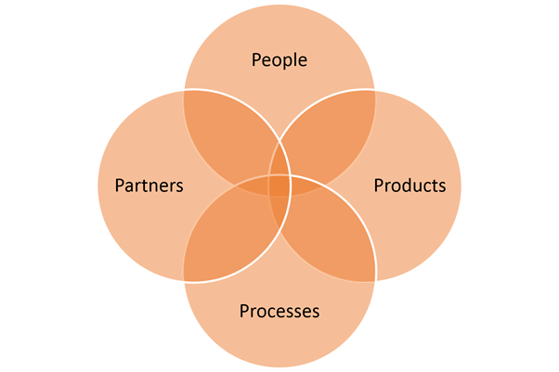
2. Service design
The service design phase of the ITIL framework focuses on seven processes and the Four Ps of Service Design. Its primary goal is to prevent costly service disruptions that arise in response to inefficient workflow. Each of the Ps represents an area of focus crucial to consider when designing the IT service infrastructure.

Slide 10
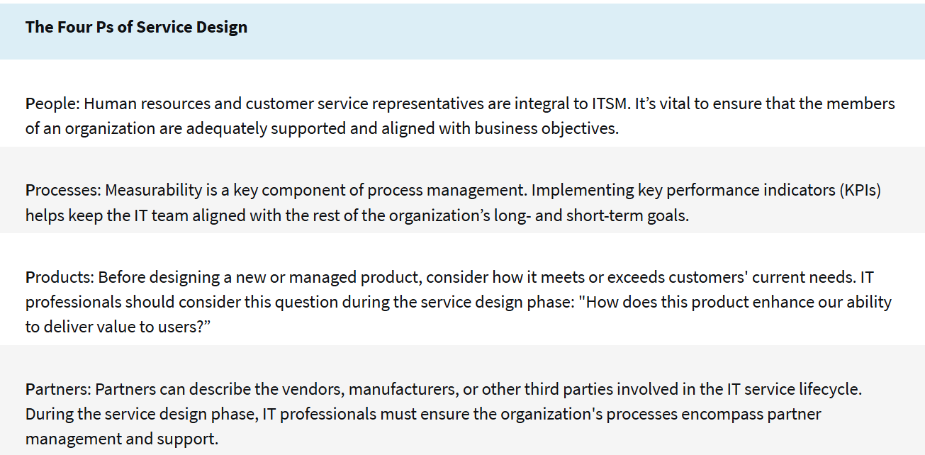

Slide 11
The seven service design processes
Service catalog management. A service catalog is the subset of IT services directly available to customers. Typically, these are the offerings within the larger service portfolio visible to users.
Service level management. Service level management refers to the Service Level Agreements (SLAs) and Operational Level Agreements (OLAs) made between the customer and the IT provider. These agreements represent the agreed-upon performance of a system or service.
Availability management. The availability management process deals with the ability of a system or service to function when the customer requests it. Availability requirements are established in the SLA agreements secured during the service level management process above.
Capacity management. ITIL defines capacity as the “maximum throughput a service, system, or device can handle.” There are three primary areas of focus involved with capacity management—Business Capacity Management (BCM), Service Capacity Management (SCM), and Component Capacity Management (CCM).
Service continuity management. This component of the ITIL foundation is often referred to as IT service continuity management (ITSCM). It secures the service provider's ability to meet the agreed-upon service-level threshold. Techniques involved with ITSCM include Business Impact Analysis (BIA) and Management of Risk (MOR).
IT security management. IT security management is centered around five major qualities: confidentiality, integrity, availability, authenticity, and non-repudiation.
Supplier management. Supplier management ensures that the organization receives the agreed-upon service levels from its partners. It’s similar to service level management, but unlike service management, it deals with internal negotiations.

Slide 12
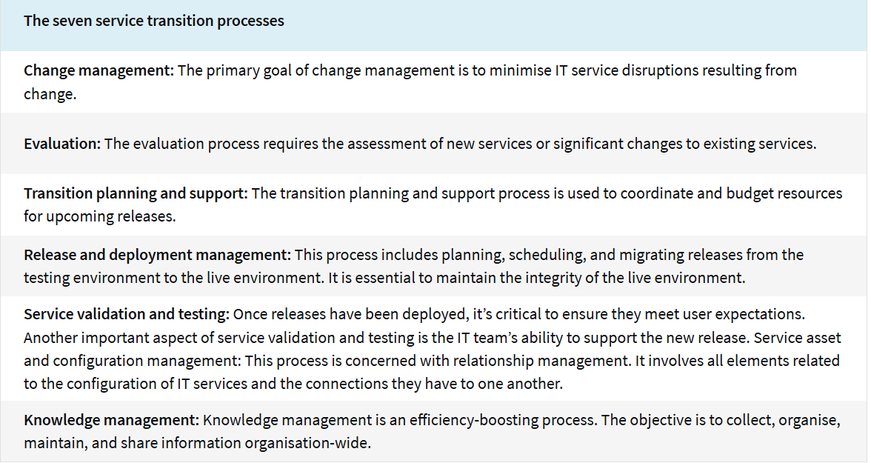
3. Service transition This ITIL phase coordinates the building, testing, and deployment of IT services. Plans must include the configuration of hardware and software, the readying of production environments, and the management of support personnel.

Slide 13
4. Service operations This phase of the ITIL framework caters to meeting end-user expectations. It includes five processes and four functions
ITIL service operations processes
Event management: Event management verifies that configuration items (CI) and services are consistently monitored and that any issues are reported and escalated to the appropriate parties.
Incident management: This process aims to return services to normal operation swiftly after a disruption.
Request fulfillment: Service requests should be acknowledged and resolved as soon as possible.
Access management: Access management is the process of granting authorised users access to services. It also encompasses activities related to protecting those services from unauthorised users. It is sometimes referred to as rights management or identity management.
Problem management: The problem management process includes both incident prevention and incident impact management.

Slide 14
ITIL service operations functions
IT operations management: IT operations management is the function that oversees all functions. It includes monitoring and controlling the entire IT service infrastructure, from routine tasks and maintenance to job scheduling.
Service desk: The service desk is the portal in which help desk technicians connect with customers. Its primary functions are incident resolution, communication, and service request management.
Application management: Application management oversees applications throughout the entirety of their life cycles.
Technical management: Technical management supports the IT infrastructure through expertise and support.

Slide 15
5. Continual Service Improvement (CSI) The fifth ITIL phase is ongoing, hence its focus on continual improvement. The goal is to continually improve the efficiency and quality of IT services and infrastructure. CSI analyses past performance and uses quality management methods to improve existing processes.
seven-step process comprises CSI:
1. Identifying improvement strategies
2. Defining what will be measured
3. Gathering data
4. Processing data
5. Analysing data
6. Presenting and using the information drawn from the data
7. Using the information to improve

Slide 16
